Slide 1
Analytical Methods for Business
Dr. Ronald K. Satterfield
Muma College of Business
University of South Florida

Slide 2
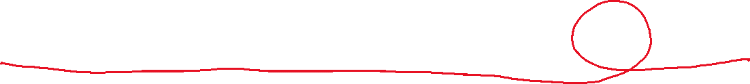
Simple Linear Regression Everything I Need to Know I Learned in the 7th Grade
Dr. Ronald K. Satterfield
Muma College of Business
University of South Florida

Slide 3
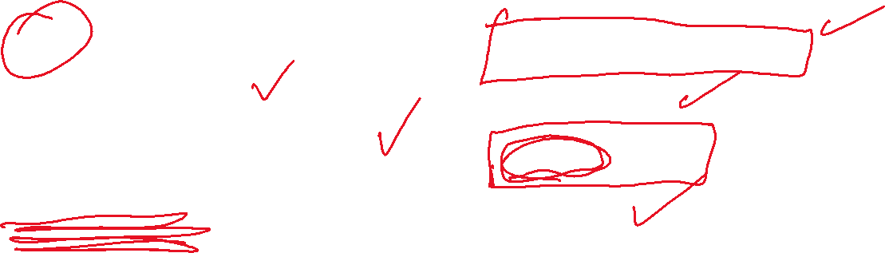
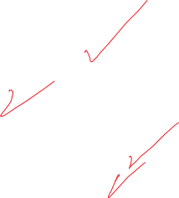
Plan for This Presentation
Ideas Behind Linear Regression
Define Important Terms
Demonstrate a Regression Analysis
Interpret Results
Assumptions of Regression
Potential Pitfalls
Residual Analysis
Conclusion
Introduction | The 7th Grade | Variation | Examples | Assumptions
Confidence Intrvls. | Being Careful | Pitfalls | Summary | Next Time

Slide 4




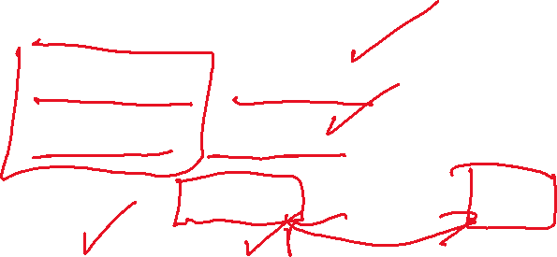

Terms to Watch For
Independent or Explanatory Variable
Dependent or Response Variable
Regression Equation or Regression Model
Slope and Intercept
Correlation
Ordinary Least Squares (OLS) Regression
LINE
Introduction | The 7th Grade | Variation | Examples | Assumptions
Confidence Intrvls. | Being Careful | Pitfalls | Summary | Next Time

Slide 5
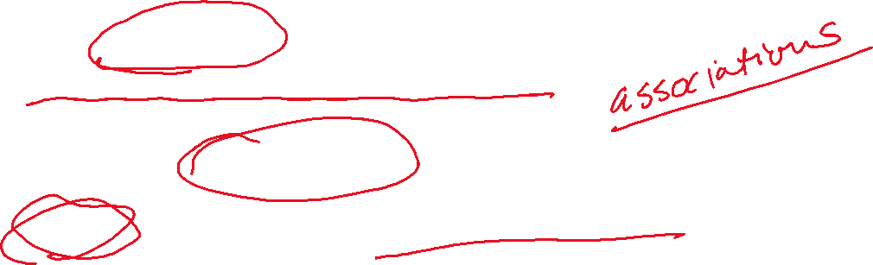
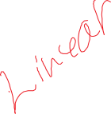
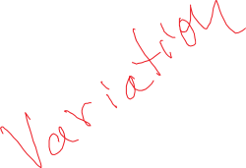
Simple Linear Regression
One of the most commonly used statistical analysis techniques, both in and out of business.
Working to determine associations between variables.
Be careful to not think in terms of “Cause and Effect”.
Introduction | The 7th Grade | Variation | Examples | Assumptions
Confidence Intrvls. | Being Careful | Pitfalls | Summary | Next Time
Notes:
5

Slide 6

The Foundations
Introduction | The 7th Grade | Variation | Examples | Assumptions
Confidence Intrvls. | Being Careful | Pitfalls | Summary | Next Time
Notes:
6

Slide 7
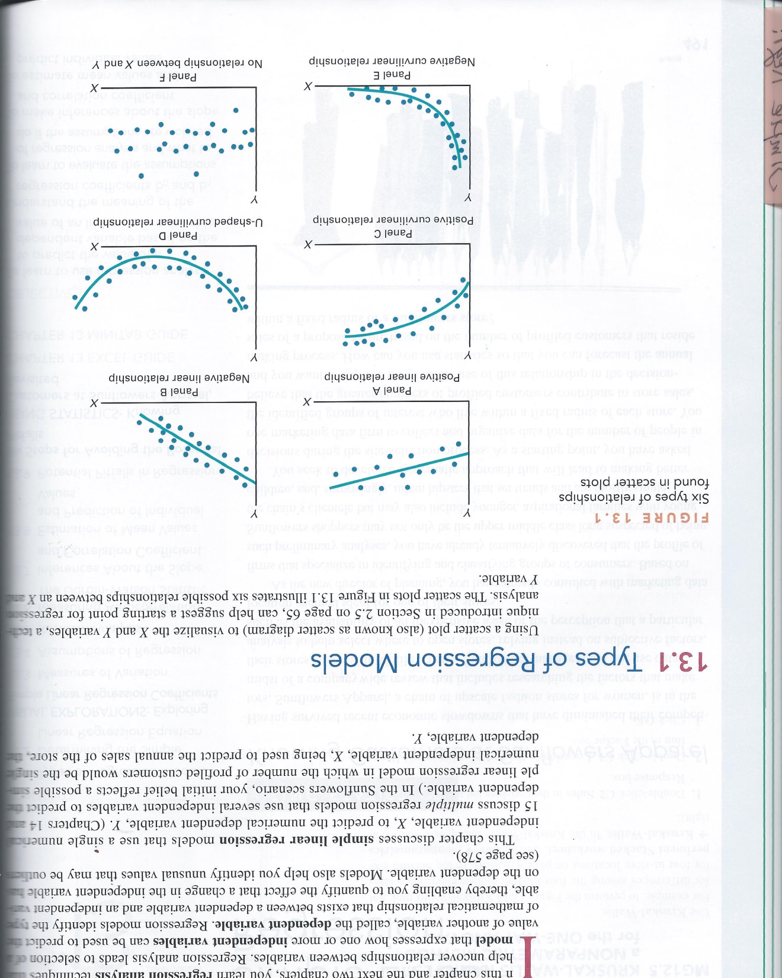


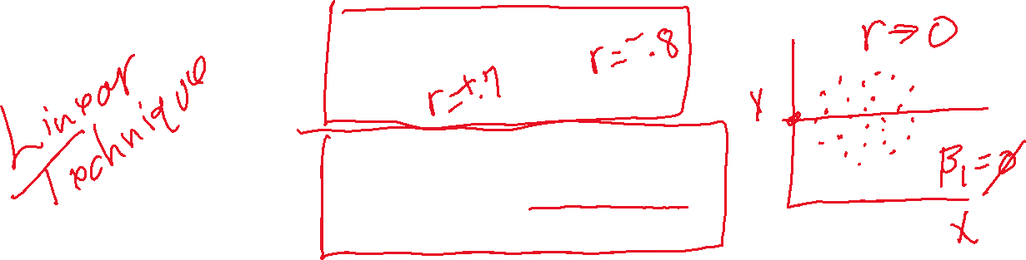
Where Does Regression Work Well?
Introduction | The 7th Grade | Variation | Examples | Assumptions
Confidence Intrvls. | Being Careful | Pitfalls | Summary | Next Time
Notes:
7

Slide 8
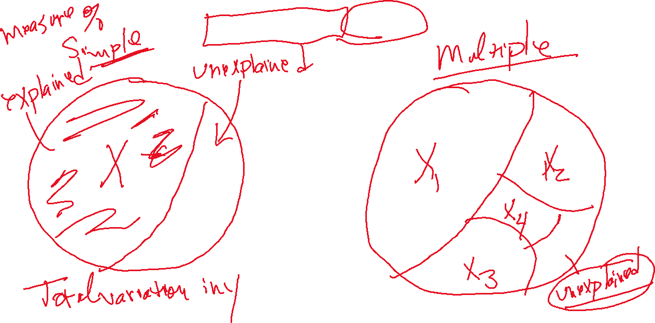

“Explaining” Variation
Introduction | The 7th Grade | Variation | Examples | Assumptions
Confidence Intrvls. | Being Careful | Pitfalls | Summary | Next Time
Notes:
8

Slide 9
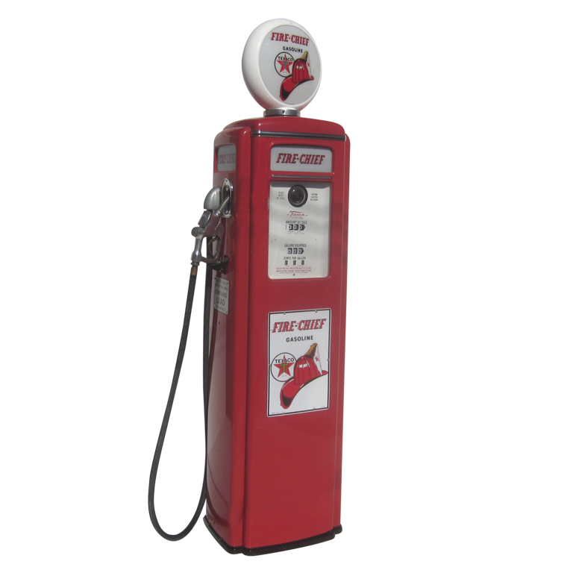
Conducting a Regression Analysis
Data Set: Oil and Gas
Introduction | The 7th Grade | Variation | Examples | Assumptions
Confidence Intrvls. | Being Careful | Pitfalls | Summary | Next Time
Notes:
9

Slide 10
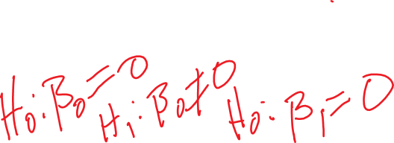

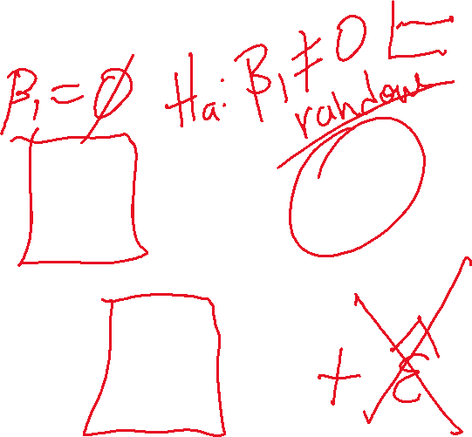


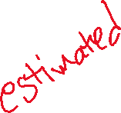




Simple Regression Models
Introduction | The 7th Grade | Variation | Examples | Assumptions
Confidence Intrvls. | Being Careful | Pitfalls | Summary | Next Time
Notes:
10

Slide 11
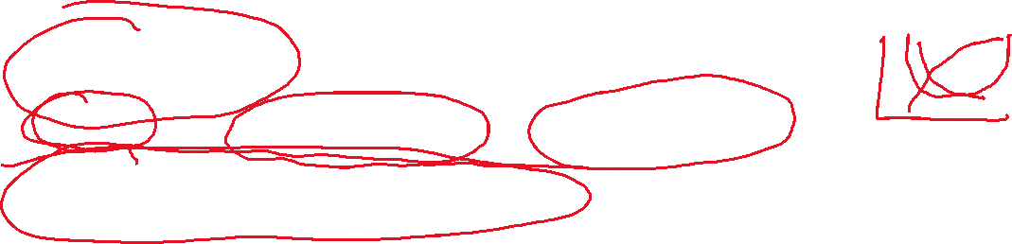
Common Mistakes in Using Regression
Data Not Linear (Without Using Appropriate Fixes)
X Value Used is Outside the Range of the Original X Values
Forgetting that Error is Going to Happen
Introduction | The 7th Grade | Variation | Examples | Assumptions
Confidence Intrvls. | Being Careful | Pitfalls | Summary | Next Time
Notes:
11

Slide 12
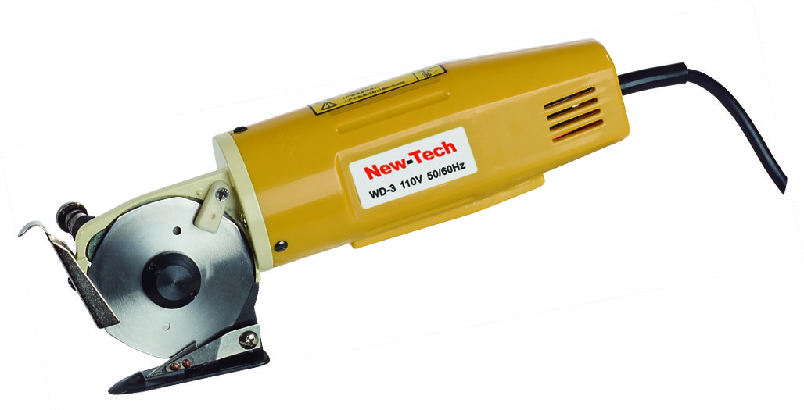
Conducting a Regression Analysis
Data Set: Cutting Tools
Introduction | The 7th Grade | Variation | Examples | Assumptions
Confidence Intrvls. | Being Careful | Pitfalls | Summary | Next Time
Notes:
12

Slide 13
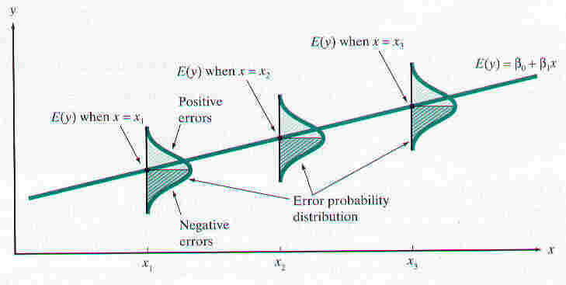

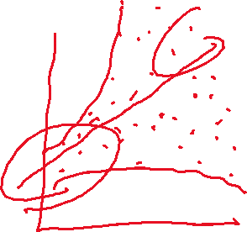

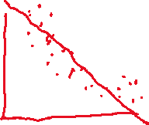


Regression Assumptions (L.I.N.E.)
Be very familiar with the model assumptions.
Introduction | The 7th Grade | Variation | Examples | Assumptions
Confidence Intrvls. | Being Careful | Pitfalls | Summary | Next Time
Notes:
13

Slide 14
Regression Assumptions (L.I.N.E.)
Linearity
Independence
Normality
Equality of Variances
Introduction | The 7th Grade | Variation | Examples | Assumptions
Confidence Intrvls. | Being Careful | Pitfalls | Summary | Next Time
Notes:
14

Slide 15
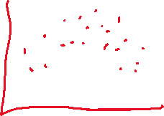
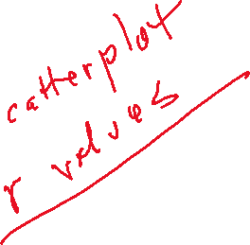
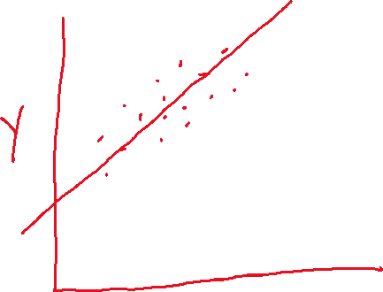
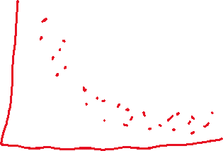

Regression Assumptions (L.I.N.E.)
Linearity
Independence
Normality
Equality of Variances
Introduction | The 7th Grade | Variation | Examples | Assumptions
Confidence Intrvls. | Being Careful | Pitfalls | Summary | Next Time
Notes:
15

Slide 16
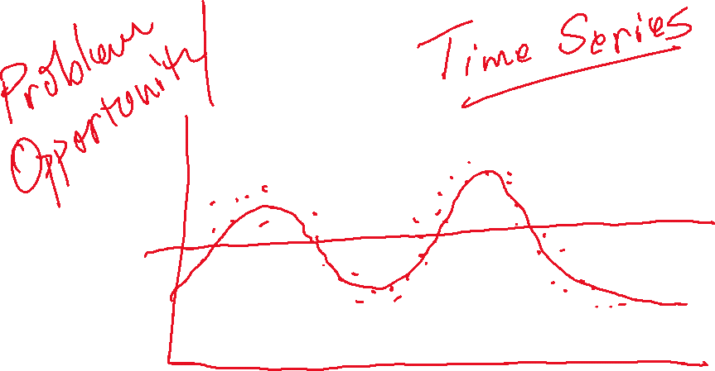
Regression Assumptions (L.I.N.E.)
Linearity
Independence
Normality
Equality of Variances
Introduction | The 7th Grade | Variation | Examples | Assumptions
Confidence Intrvls. | Being Careful | Pitfalls | Summary | Next Time
Notes:
16

Slide 17
Regression Assumptions (L.I.N.E.)
Linearity
Independence
Normality
Equality of Variances
Introduction | The 7th Grade | Variation | Examples | Assumptions
Confidence Intrvls. | Being Careful | Pitfalls | Summary | Next Time
Notes:
17

Slide 18
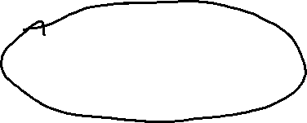
Regression Assumptions (L.I.N.E.)
Linearity
Independence
Normality
Equality of Variances
Introduction | The 7th Grade | Variation | Examples | Assumptions
Confidence Intrvls. | Being Careful | Pitfalls | Summary | Next Time
Notes:
18

Slide 19

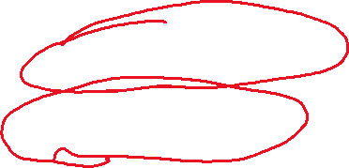
Regression Assumptions (L.I.N.E.)
Linearity
Independence
Normality
Equality of Variances
Heteroscedasticity
Homoscedasticity
Introduction | The 7th Grade | Variation | Examples | Assumptions
Confidence Intrvls. | Being Careful | Pitfalls | Summary | Next Time
Notes:
19

Slide 20
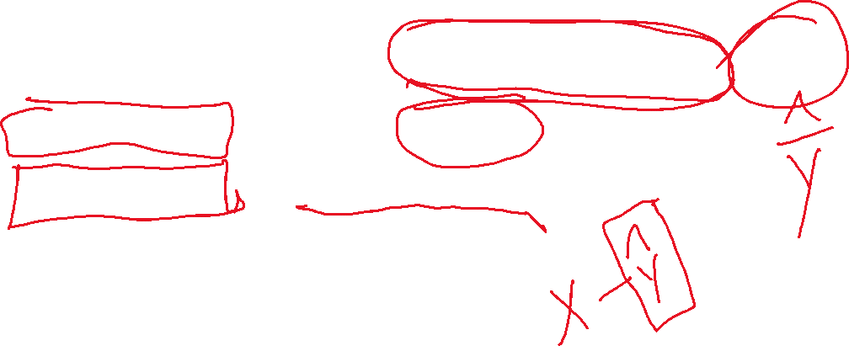
Two Kinds of Confidence Intervals on y
Confidence Interval Estimate for the Mean of y
Prediction Interval for an Individual Response
Introduction | The 7th Grade | Variation | Examples | Assumptions
Confidence Intrvls. | Being Careful | Pitfalls | Summary | Next Time
Notes:
20

Slide 21

Being Careful with Regression
Data Set: Child Abuse
Introduction | The 7th Grade | Variation | Examples | Assumptions
Confidence Intrvls. | Being Careful | Pitfalls | Summary | Next Time
Notes:
21

Slide 22

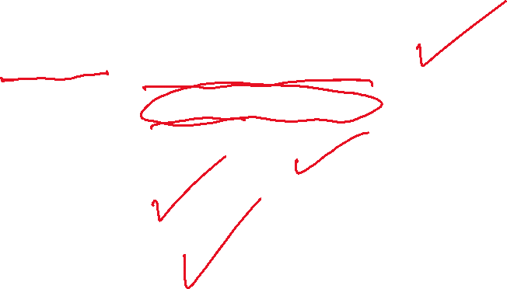
Potential Pitfalls
Assumptions of Regression (Not Aware, Not Checking for Violations)
Not Knowing How to Assess the Impact of Assumption Violations
Using Regression Without Understanding Subject Matter
Extrapolating Outside the Relevant Range
Assuming Cause-and-Effect Between x and y
Introduction | The 7th Grade | Variation | Examples | Assumptions
Confidence Intrvls. | Being Careful | Pitfalls | Summary | Next Time
Notes:
22

Slide 23
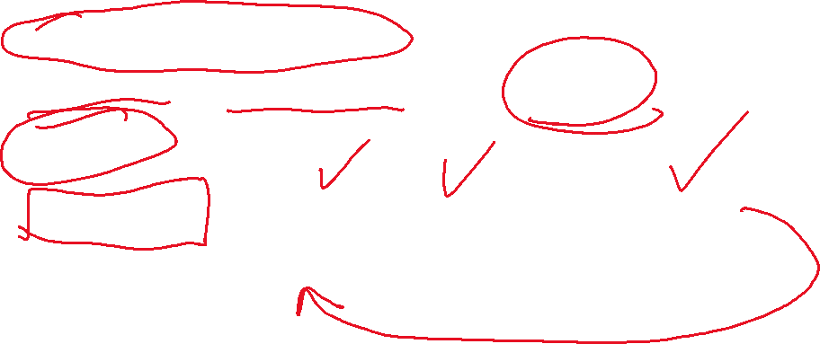
What Have We Covered?
Simple Linear Regression
Background and Theory of Regression and OLS Technique
Examples
Interpretation (Correlations, Coefficients, Residual Analyses)
Assumptions of Regression (L.I.N.E.)
Introduction | The 7th Grade | Variation | Examples | Assumptions
Confidence Intrvls. | Being Careful | Pitfalls | Summary | Next Time

Slide 24
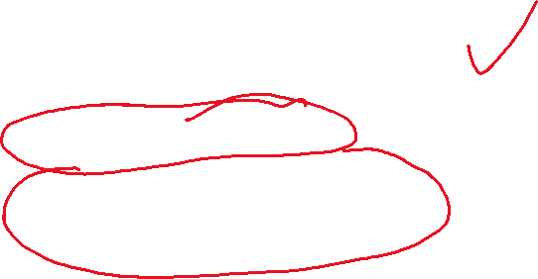
Where are We Going?
Further Practice with Regression
Regression with R
In-Class Assignment with R
Introduction | The 7th Grade | Variation | Examples | Assumptions
Confidence Intrvls. | Being Careful | Pitfalls | Summary | Next Time

